Slide 1

Database Management System (CS232) gg
Week 01
Said Nabi
said.nabi@giki.edu.pk
Faculty of Computer Science and engineering
Gik Institute Topi, Swabi

Slide 2
Course TA
Instructor
Email: said.nabi@giki.edu.pk
Webpages: https://tecplace.net/ https://humanizetextai.com/
Office: NAB 2nd Floor, S22
Telephone Extension: 2154
Office Hours:
Monday/Thursday 9:00 AM - 4:00 PM
Yet to be decide
Never hesitate to contact TA or me whenever you have some problem

Slide 3
Some Rules
There is only one rule that will make the rest of the rules
Raise your hand before asking any question and then WAIT for the permission
Never ever miss a class
Never ever “sleep” in the class
Never even think to use mobile phones in the class
Always communicate in the official communication language

Slide 4
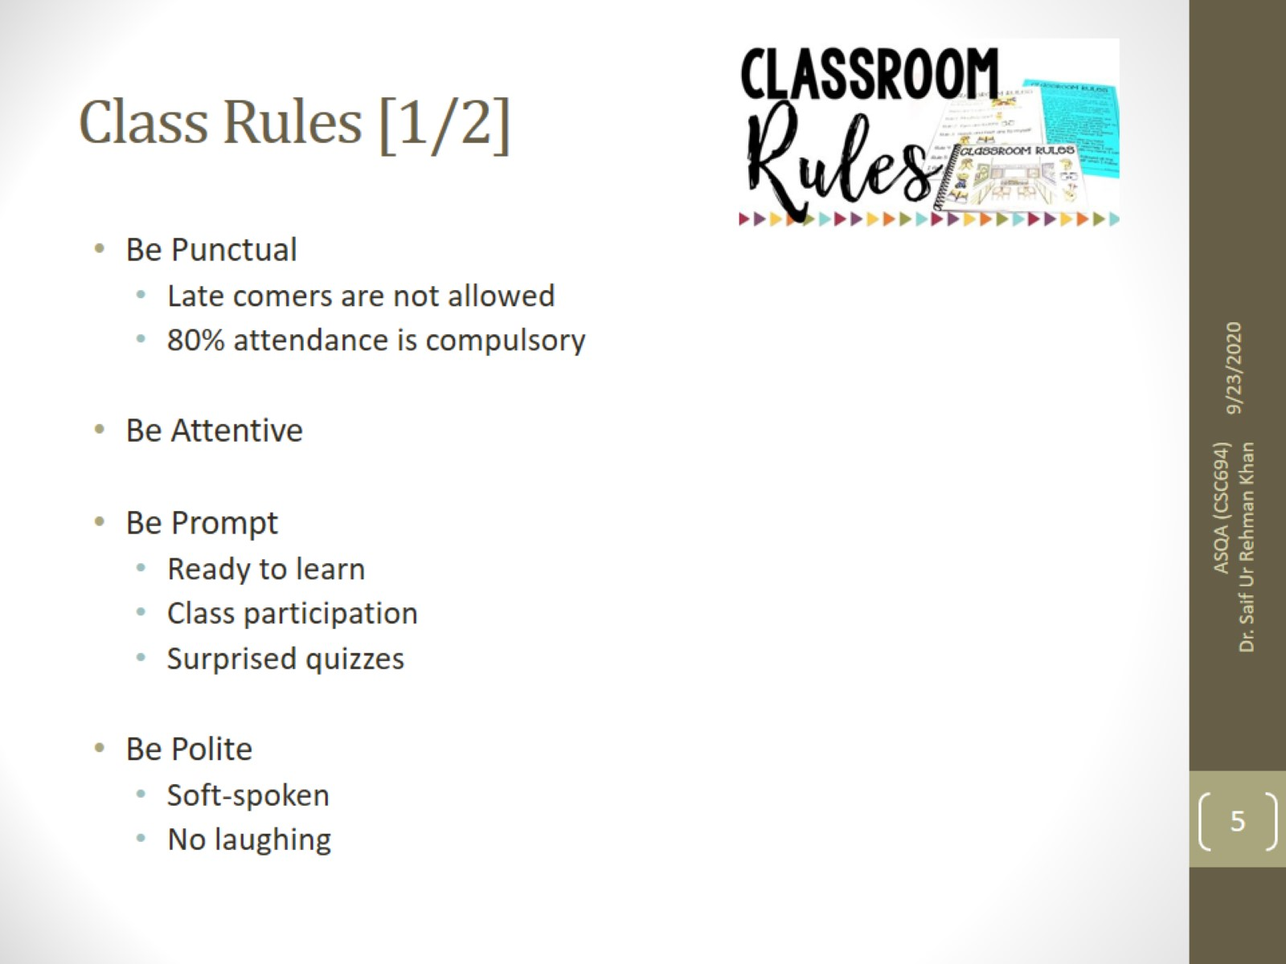
20/01/2025
4

Slide 5
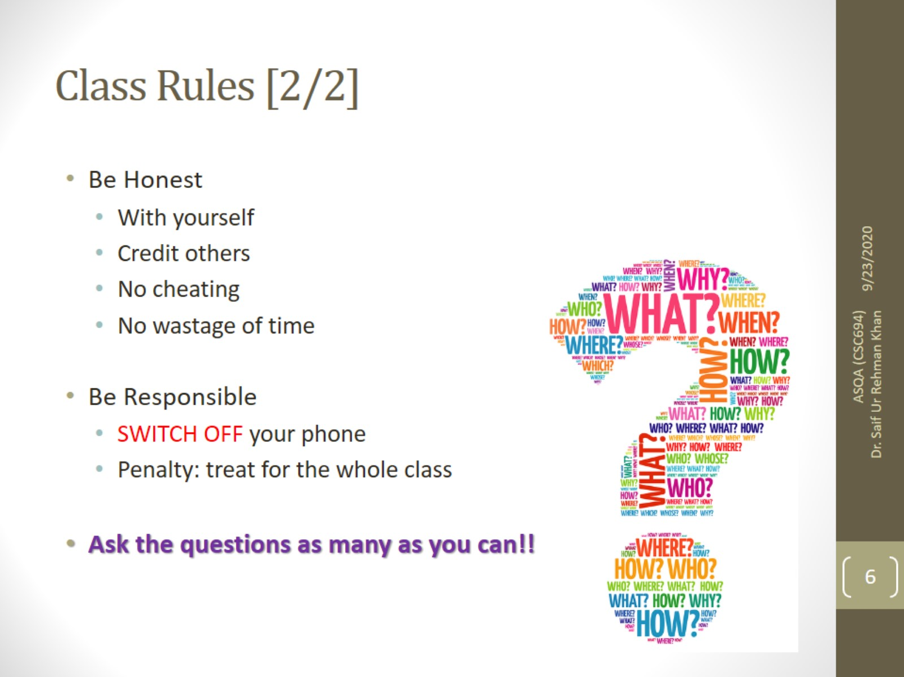

Slide 6
Dishonesty, Plagiarism in Quizzes, Assignments
All individuals involved in any kind of cheating in any exam, quiz, assignment or project will get -50% score.

Slide 7
Tentative Evaluation Breakdown
Assignments (6) | 10
Quizzes (6) | 15
Term Project (1) | 15
Midterm (1) | 20
Final (1) | 40
Total | 100

Slide 8
Course Execution
3 lectures of one hour every week
1 lab of three hours every week, CS232L
Mind it: Lecture scheduling is to be done by the Dir. (A&E). Please avoid visiting me for any clashes

Slide 9
Text books:
• Elmasri, R., Navathe: “Fundamentals of Database Systems”, 7th Edition, Pearson. (2015).
Reference books:
• Silberschatz, A., Korth, H. and Sudarhshan., S: “Database System Concepts”, 6th Edition, McGraw-Hill Education, New York (2010).
• Date, C,J.: "An Introduction to Database Systems", 8th Edition, Pearson, Boston (2010)

Slide 10
Notes
Course contents and their order may be slightly modified during the course execution.
No make up for missed quizzes or assignments/homeworks
Deadline for assignments and projects are always final.
Quizzes may be announced or un-announced
Serious action will be taken for any kind of cheating
Same number of quizzes and assignment will be in lab as in course
Mid and Final exam of lab will be conducted on Computer

Slide 11

Motivation
Learning DBMS equips you with the skills to organize, manage, and retrieve data efficiently.
Core of backend development
Scalable and efficient software development
Opens the door to trending technologies like Big Data, Data Science, and Cloud Computing

Slide 12
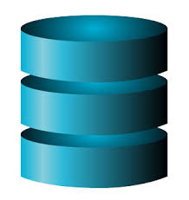
Topics
Basics of DBMS
Data VS Information
Importance of Data
What is DBMS
Applications of DBMS
Example of DBMS
Users of DBMS
Drawbacks of File Systems
DBMS Vs File Systems

Slide 13
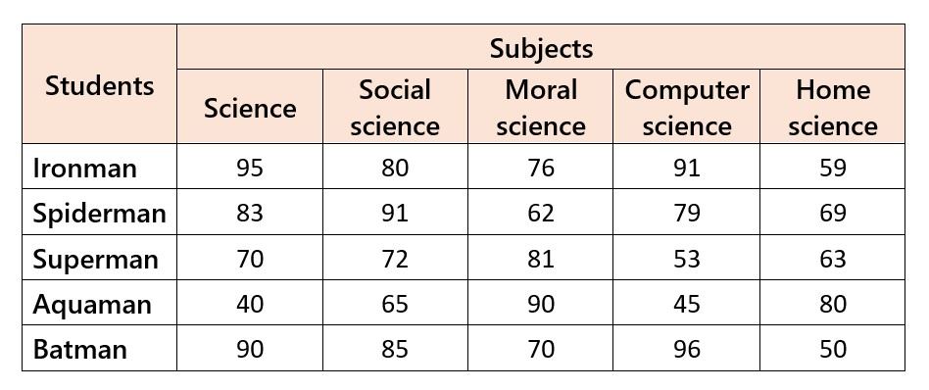
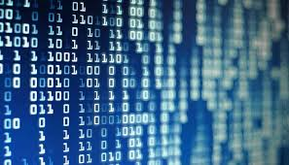
Data
known facts that can be recorded and that have implicit meaning
Integers,strings or images are represented in 0s and 1s
Notes:
Data is a plural Latin word, with the singular form being 'datum,' meaning 'given.' The term was first used in the English language in the 1640s.
For example, a phone book contains data such as names, phone numbers, and addresses.

Slide 14
Information
Processed data
We can interpret
Can make decisions based on the information

Slide 15
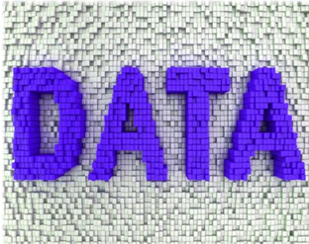



Slide 16
Why Information Is Important?
Improve People’s Lives
Make Informed Decisions
Find Solutions To Problems
Back Up Your Arguments
Be Strategic In Your Approaches
Make The Most Of Your Money
Keep Track Of It All
Stop The Guessing Game

Slide 17




We Live in a World of Data
2.9 million emails are sent every second
20 hours of video are uploaded to YouTube every minute
24 PBs of data are processed by Google every day
50 million tweets are generated per day
700 billion total minutes are spent on Facebook each month
72.9 items are ordered on Amazon every second

Slide 18
The Importance of Data
Data is the new oil. Clive-Humby
Helps in making informed decisions, solving problems, and improving processes
Healthcare providers, online stores, weather services, and ride-sharing apps use data

Slide 19

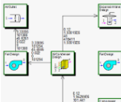
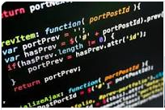

Components of Information System
Web & GUI
Designing/ Modeling
Coding/ Programming
SQL Programming
Database (Data Storage)

Slide 20
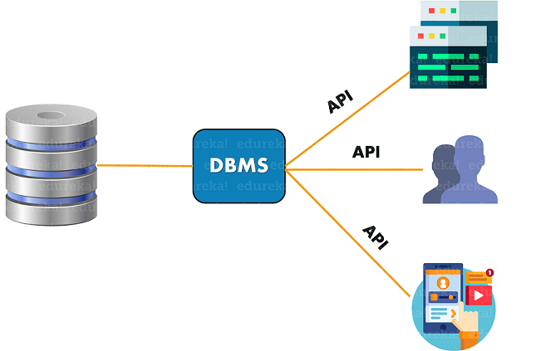
Database
An electronic place where data is stored so that
It can be accessed managed and updated easily
DBMS
A Collection of interrelated data and set of programs to access those data.

Slide 21
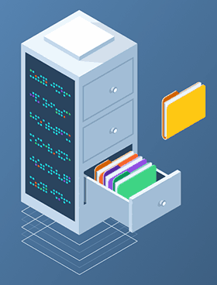
Some Definitions
A database is a collection of data which describes one or many real-world enterprises
E.g., a university database might contain information about entities like students and courses, and relationships like a student enrollment in a course
A DBMS is a software package designed to store and manage databases
E.g., DB2, Oracle, MS SQL Server, MySQL and Postgres
A database system = Data + DBMS + Application Programs

Slide 22
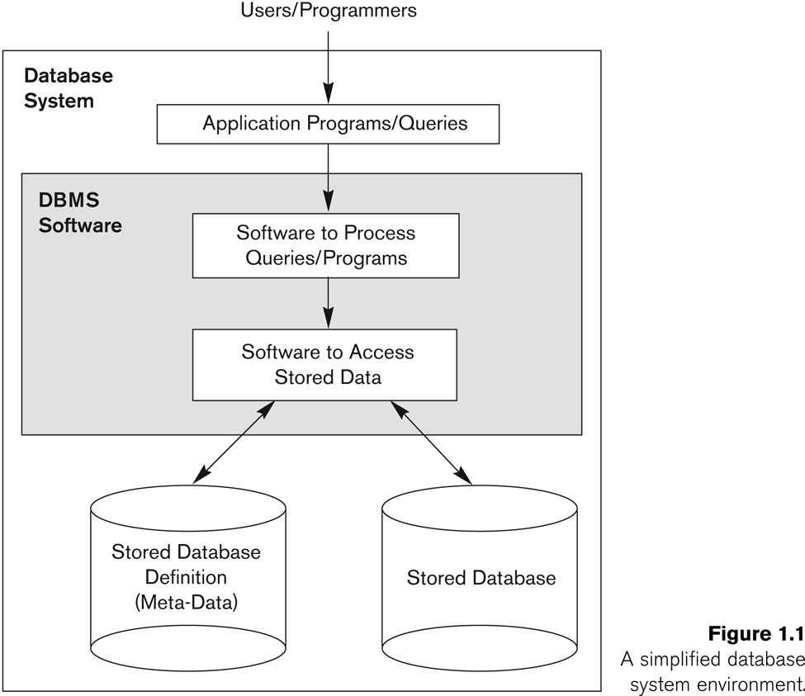
Simplified database system environment (Figure 1.1)

Slide 23



Application of DBMS
DBMS applications streamline the storage, retrieval, and management of data in various industries like banking, e-commerce, and education.

Slide 24
Application of DBMS Cont..
More Recent Applications:
Multimedia Databases (images, videos, voice, etc.)
Geographic Information Systems (GIS)
Data Warehouses (OLAP)
Real-time and Active Databases
Many other applications

Slide 25
Data Base Management Systems
A special software is accordingly needed to make the preceding tasks easier
This software is known as Data Base Management System (DBMS)
DBMSs provide automatic:
Data independence
Efficient data access
Data integrity and security
Data administration
Concurrent access and crash recovery

Slide 26
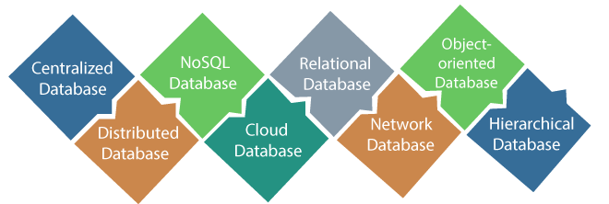
Types of DBMS

Slide 27
Operations with Databases
• Design
– Define structure and types of data
• Construction
– Create data structures of DB, populate DB with data
• Manipulation of Data
– Insert, delete, update
– Query: “Which department pays the highest salary?”
– Create reports:
“List monthly salaries of employees, organized by department, with average salary and total sum of salaries for each dept”

Slide 28
Example of a Database UNIVERSITY Application
Mini-world for the example:
Part of a UNIVERSITY environment.
Some mini-world entities:
STUDENTs
COURSEs
SECTIONs (of COURSEs)
(academic) DEPARTMENTs
INSTRUCTORs

Slide 29
Example of a Database UNIVERSITY Application (cont.)
Some mini-world relationships:
SECTIONs are of specific COURSEs
STUDENTs take SECTIONs
COURSEs have prerequisite COURSEs
INSTRUCTORs teach SECTIONs
COURSEs are offered by DEPARTMENTs
STUDENTs major in DEPARTMENTs
Note: The above entities and relationships are typically expressed in a conceptual data model, such as the ENTITY-RELATIONSHIP data model (see Chapters 7, 8)

Slide 30
Example of a Database UNIVERSITY Application (cont.)

Slide 31
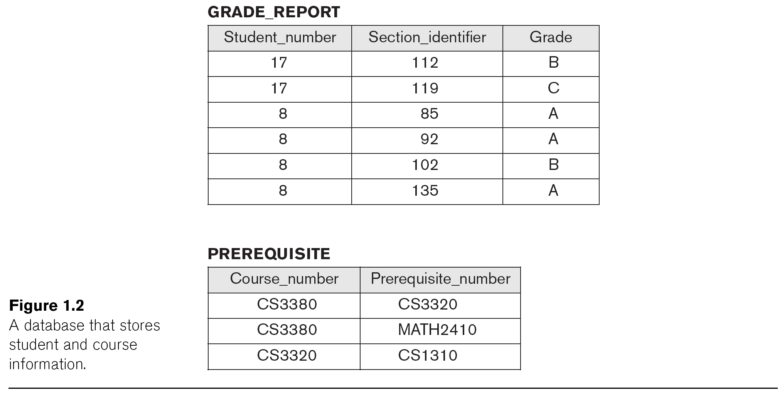
Example of a Database UNIVERSITY Application (cont.)

Slide 32
Main Characteristics of the Database Approach
Self-describing nature of a database system:
A DBMS catalog stores the description of a particular database (e.g. data structures, types, and constraints)
The description is called meta-data (see next slide).
This allows the DBMS software to work with different database applications (university, bank, airlines, etc.)
Insulation between programs and data:
Called program-data independence.
Allows changing data structures and data storage organization without having to change the DBMS access programs.

Slide 33
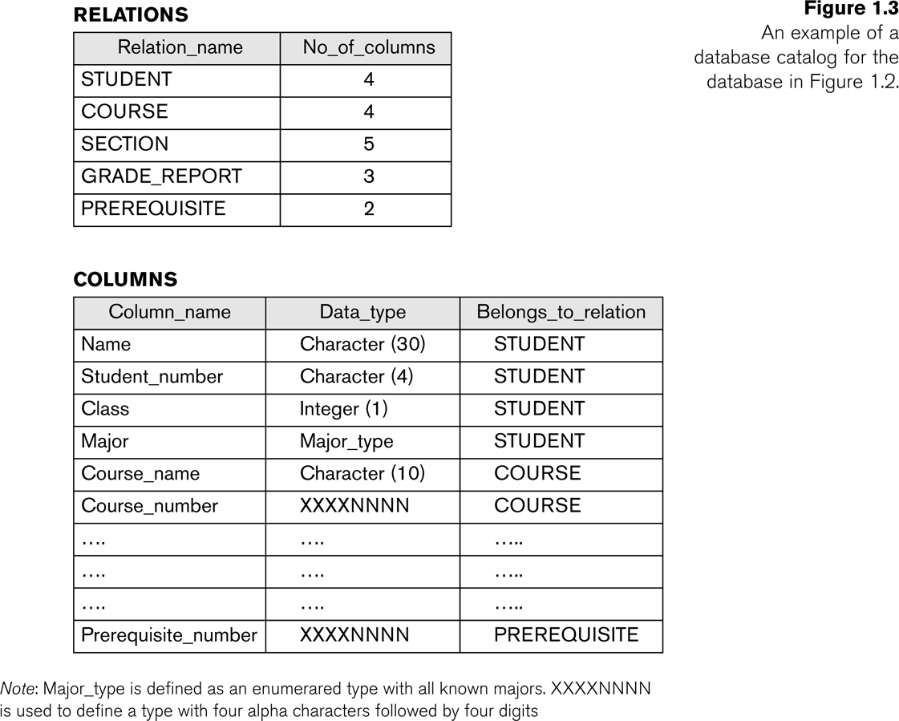
Example of meta-date in a simplified database catalog (Figure 1.3)
Notes:
Relations= Tables
Columns= Fields

Slide 34
Main Characteristics of the Database Approach (cont.)
Insulation between programs and data (cont.):
Accomplished through data abstraction
A data model is used to hide storage details and present the users with a conceptual view of the database.
Programs refer to the data model constructs rather than data storage details
Support of multiple views of the data:
Each user may see a different view of the database, which describes only the data of interest to that user.

Slide 35
Main Characteristics of the Database Approach (cont.)
Sharing of data and multi-user transaction processing:
Allowing a set of user transactions to access and update the database concurrently (at the same time).
Concurrency control within the DBMS guarantees that each transaction is correctly executed or aborted
Recovery subsystem ensures each completed transaction has its effect permanently recorded in the database
OLTP (Online Transaction Processing) is a major part of database applications (allows hundreds of concurrent transactions to execute per second)

Slide 36
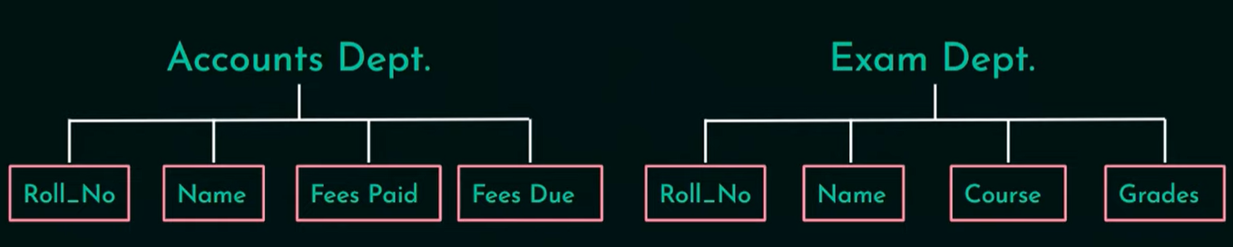
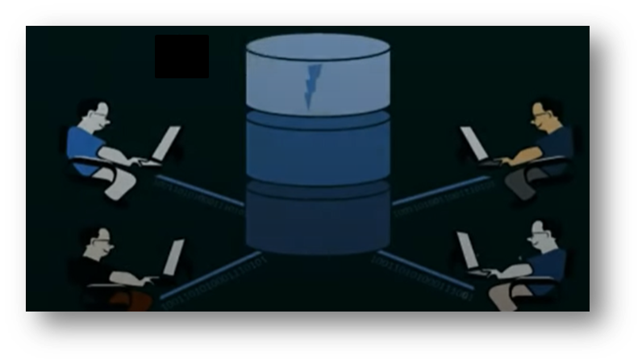
Why Not File System?
Why DBMS?

Slide 37
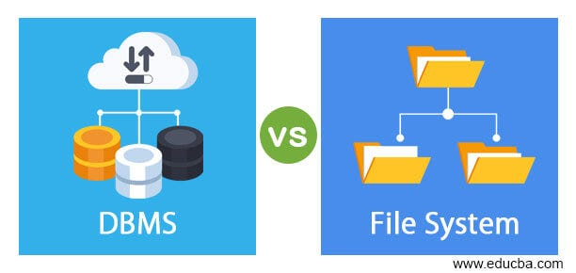
Drawbacks of File Systems
File Systems store redundantly and inconsistently
Difficulties in data retrieval
Data Isolation
No data Security
Concurrent Access Issues
Integrity Problems
Atomicity Problems

Slide 38
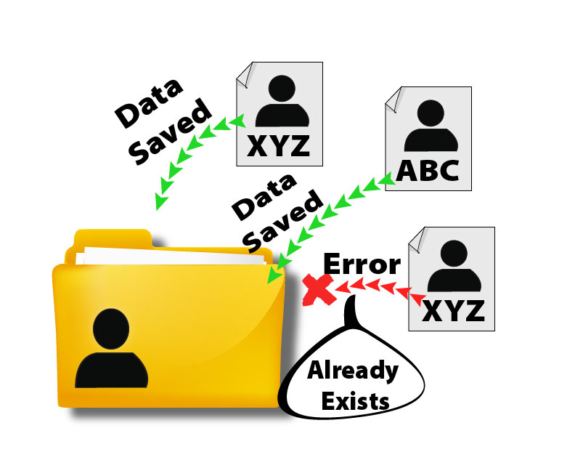
Data Redundancy & Data Inconsistency

Slide 39

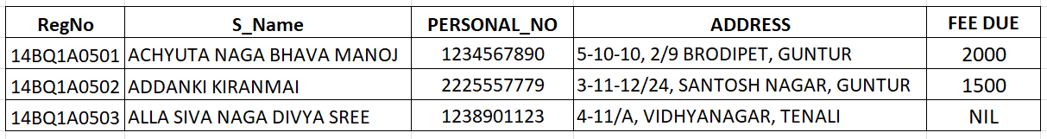

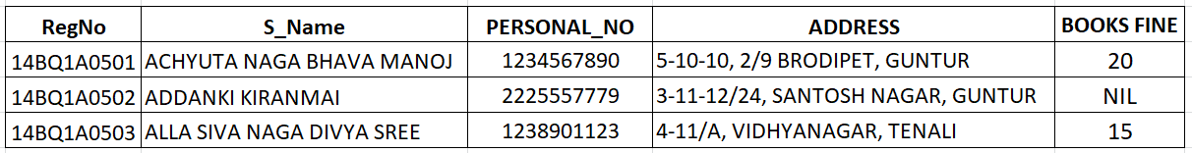

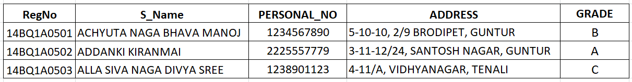
Continue…
Admission
Libarary
Transport

Slide 40
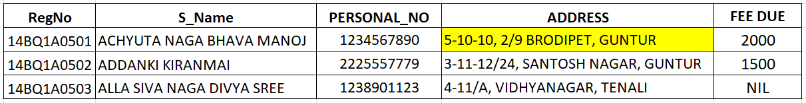
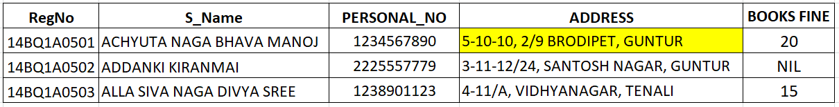
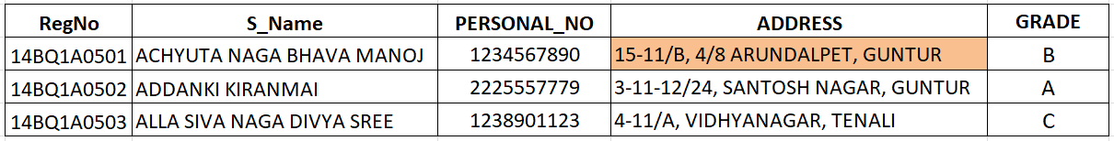
Continue…
Admission
Libarary
Transport

Slide 41


2. Difficulty in Data Retrieval
Admission
Libarary
Transport

Slide 42
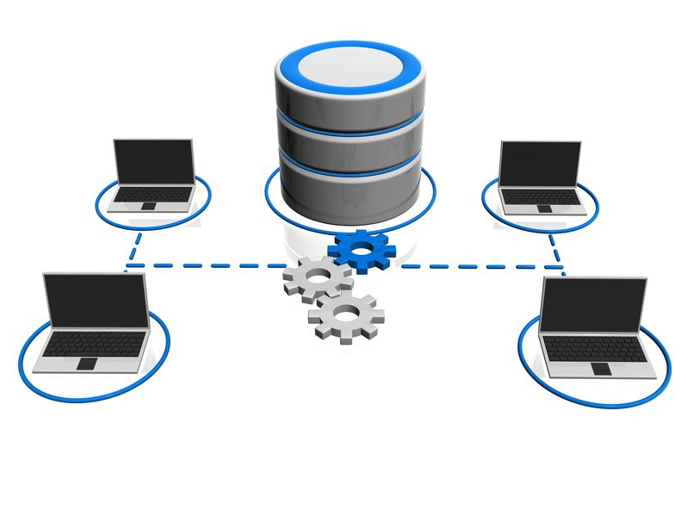
3. Data Isolation

Slide 43

4. Integrity Problems
Notes:
There may be cases when some constraints need to be applied on the data before inserting it in database. The file system does not provide any procedure to check these constraints automatically. Whereas DBMS maintains data integrity by enforcing user defined constraints on data by itself.

Slide 44

5. Atomicity Problems
Account A
Account B
Initial Balance: 1000/-
Initial Balance: 2000/-
Fund Transfer of 800/- from Account A to Account B
Notes:
Atomicity of a transaction refers to “All or nothing”, which means either all the operations in a transaction executes or none.

Slide 45


6. Concurrent Access Anomalies
Notes:
Concurrent access to data means more than one user is accessing the same data at the same time. Anomalies occur when changes made by one user gets lost because of changes made by other user.

Slide 46

7. Security
Notes:
Data Security: Data should be secured from unauthorised access, for example a student in a college should not be able to see the payroll details of the teachers, such kind of security constraints are difficult to apply in file processing systems.
DBMS has specialized features that help provide shielding to its data.

Slide 47
Purpose of DBMS
Database systems offer solutions to all the above problems

Slide 48
Advantages of DBMS over file system
Fast Data Access: The data response time increases in DBMS.
Minimized Data Redundancy: DBMS has different constraints using them same data can't be stored in more than one places.
Data Consistency: Since DBMS solves the problem of data redundancy, the problem of data consistency is automatically solved.
No attributes for accessing the data: Here, we don't need to know the location of the file. The user makes a request from any web application or app and the server responds accordingly.

Slide 49
Advantages of DBMS over file system cont..
Concurrent Access: Multiple users can access the database at the same time when we are using the Database Management System.
Security: We have role-based access control in DBMS. Each user has a different set of access thus the data is secured from problems like data leaks, misuse of data etc.

Slide 50
Types of Database Users
Actors on The Scene
End users (EU)
Use the database system to achieve some goal
Application developers (AD)
Write software to allow end users to interface with the database system
Actors Behind The Scene
Database Administrator (DBA)
Designs & manages the database system/Provide technical support
Database systems programmer
Writes the database software itself

Slide 51

Any Questions??

